Slide 1
Beyond L&m and cX: Are there other influences on restaurant prices & Ratings?
Presented by: Marc Donatiello, Mark Visco, Rick Cavalla, Baljit Alang, & Haarris Haque

Slide 2
The Abstract
Purpose: We wanted to see if we could find any correlation between the socioeconomic demographics of a geographic area (Essex County, New Jersey) and the average price/quality of restaurants in that area.
Method: We extracted data using “Google Places” APIs, in conjunction with US Census data.
Data Used:
Google Places (Maps) API - for the following data for restaurants in each zip code:
Price ratings
Customer ratings
US Census API - for the following demographic data for each zip code in Essex County:
Median Age
Foreign Born
Household Income
Data Limitations: Google Places API only allowed 60 most proximate restaurants in their query results

Slide 3
Our Hypotheses
Hypothesis Statement
If a zip code’s average household income is low, median age is low or percent of foreign-born is high, then the average customer rating and average price level of restaurants in that zip code will be lower than a zip code with a high average household income, high median age and low percent of foreign-born.
Null Hypothesis
A zip code’s average household income, median age and percent of foreign-born are unrelated to average customer rating and average price level of restaurants in that zip code.

Slide 4
Correlations we’re hoping to find
Do higher income areas have more expensive restaurants?
Do higher income areas have better rated restaurants?
Do younger people go to cheaper restaurants? Do older age groups go to more expensive restaurants?
Does age have a correlation with average restaurant rating?
Do areas with more foreign-born residents go to more expensive/higher rated restaurants?

Slide 5
The T-Test

Slide 6
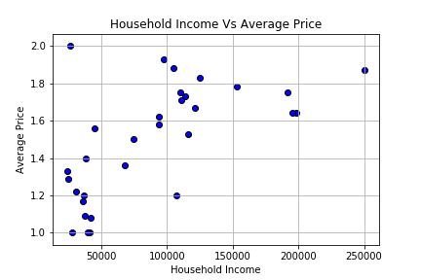
What we FouND: Income V. RESTAURANT PRICE
Here we have a comparison of Household income (X-axis) compared to Average Price (Y-axis). The household income ranged from $0-$250,000. The database generally ranged restaurants as one dollar sign ($) to four dollar signs ($$$$). Our dataset however, had no restaurants rated three dollar signs($$$) or higher.
The data shows us that in general, households that make less than $50,000 or less every year generally are surrounded by restaurants that are on the cheaper side. We see an increase in the average price of restaurants as incomes increase. An interesting thing to note is that no households that earn $125,000+ eat at any place cheaper than a 1.5 rating.

Slide 7
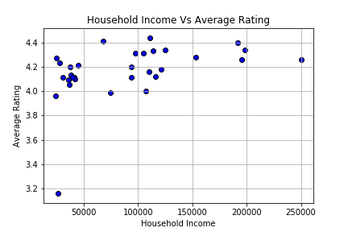
What we FouND: INCOME V. RESTAURANT RATINGS
This scatter plot compares Household Income (X-Axis) to Average Restaurant Rating (Y-Axis). Like the scatterplot before, the income is ranged from $0-$250,000. The Average Rating is scaled from 3 to to 4.6 with the maximum rating possible being a 5.
Everyone restaurants in these areas seem to have an average rating of 4/5 or higher. This could be mostly due to generous reviewers who don’t want to label a restaurant anything less than a 4. There is one noticeable outlier: The average rating for a Newark zip code is at 3.16/5.

Slide 8
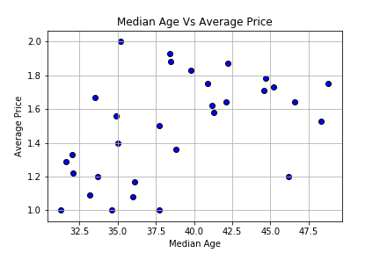
What we Found: Age V. Average price
This is a comparison between Age (X-Axis) and Average Price (Y-Axis). The Ages were scaled from the ages of 30-50 years old. The average Price were based off the database’s dollar sign rankings, just the same as in Figure 1.
This scatterplot displays how average age and average price are correlated. We can see that that 30-37.5 age group generally reside near less expensive restaurants. However, we see it’s clear that after the age 37, the population becomes patrons live closer to higher priced restaurants. There also seems to be a downward trend in terms of price as the 40+ age group gets older

Slide 9
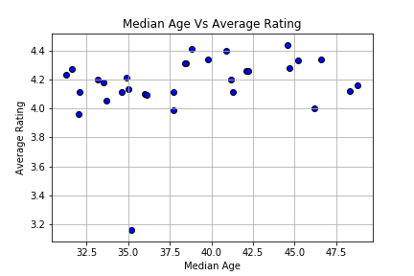
What we Found: Age v. Average Rating
The X-Axis represents the average age of restaurant patrons, scaled from 30 years old to 50 years old. The Y-Axis represents the Average Restaurant Rating, and is measured on a scaled of 1-5, with 5 being the highest possible rating.
There doesn’t seem to be any trend between age groups and the quality of restaurants they elect to dine at. Although the data does tell us that zip codes where the average age is 37+ have more higher rated restaurants than those with zip codes with more people in the 30-37 age range.

Slide 10
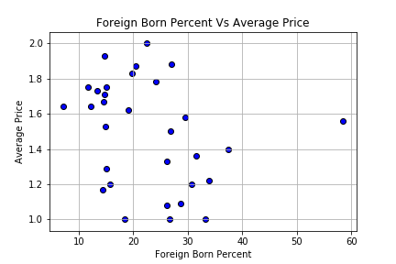
What we found: Foreign born v. Average Price
Shown here is a comparison between towns with varying Foreign Born Residents by Percentage (X-Axis) and Average Price (Y-Axis). The towns are scaled from having 0% of residents being foreign-born and extends to 60%. The average price, like previous graphs before it, are scaled from 1 dollar sign ($) to 4 dollar signs($$$$). Our data didn’t show us any restaurants that weren’t rated $$$ or higher.
This scatter plot shows us that areas with less foreign-born residents are more likely to live near more expensive restaurants. The towns that have a higher percentage of foreign-born residents generally are surrounded by cheaper restaurants

Slide 11
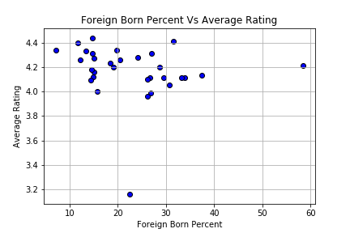
What we found: Foreign born v. Average rating
The X-Axis is same as the previous graph: it represents the Percentage of Foreign-Born Residents. The Y-Axis here represents the Average Rating of the restaurants. The restaurants are rated on a scale from 1-5, with 5 being the highest possible rating.
There doesn’t seem to be a direct correlation between foreign-born percentage and the quality of restaurants that are in their locale. One could assume that most people like to dine at pretty well (4.0) rated restaurants

Slide 12
Final Thoughts
Our research leads us to the conclusion, based on the r-values, p-values and scatterplots, that there is a relationship between average restaurant prices and household income, median age and percentage of foreign-born.
The strongest correlation is household income to average price. The results of our analysis indicate there is little to no correlation between restaurant ratings and the three demographic measures.

